Slide 1
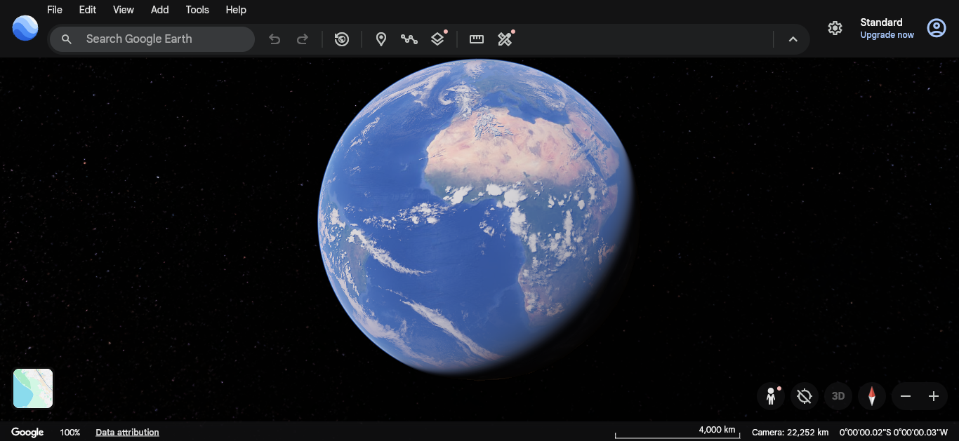
3
HCI Focus: Google Earth's 3D Viewer
1
Interaction elements that help the user control and navigate a 3D map
Interaction & Usability
1
Search / Places Bar
Lets a user type a place name to jump the camera there instantly, removing the need to manually pan and zoom to find a location.
2
2
Zoom Slider (+ / −)
Gives direct, visible control over camera distance. The buttons act as clear affordances — their shape signals “click me to zoom.”
3
Compass / Tilt Reset
Anchors the user by showing current orientation and offering one click back to north-up, straight-down view when they get disoriented.
Reflection: One HCI Change I'd Make
I would add a small on-screen label next to the compass the first time it's used, since new users often mistake it for decoration rather than a clickable tilt-reset control.
Illustrative mockup of Google Earth's 3D globe view (interaction layer)
HCI vs. Computer Graphics — Mini Assignment
Slide 1 of 2

Slide 2
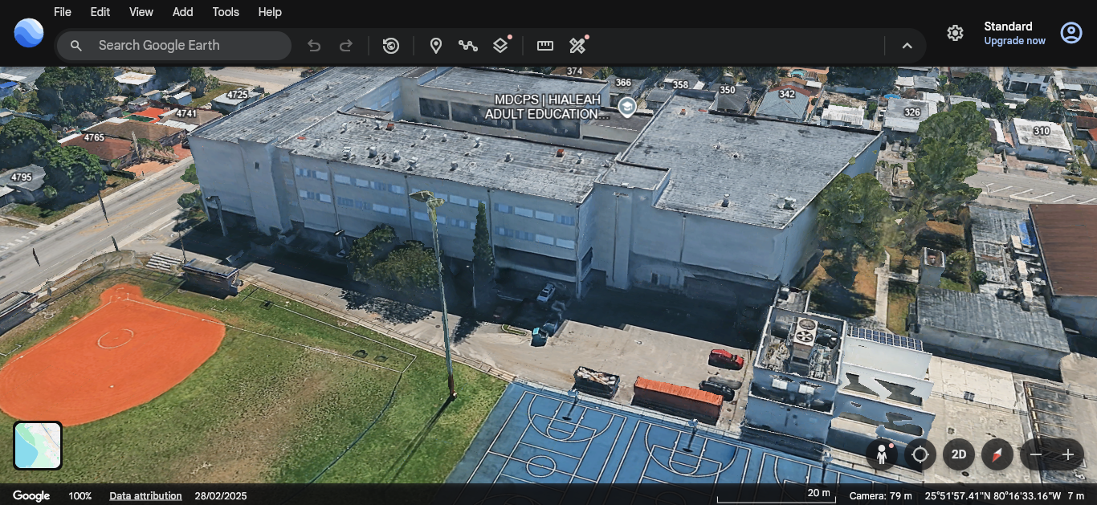
CG Focus: Google Earth's 3D Viewer
Rendering elements that build the illusion of a 3D world on a flat screen
Rendering & Visual Depth
1
Light Source & Shadowing
A simulated sun direction shades one side of the globe darker, giving the sphere volume instead of looking like a flat painted circle.
2
3D Mesh / Wireframe Geometry
Latitude and longitude lines reveal the underlying curved mesh the terrain and textures are wrapped around, defining the globe's form.
3
Perspective & Depth Cues
Buildings shrink and fade toward the back (atmospheric perspective), telling the eye which objects are near versus far away.
Reflection: Does CG Quality Help or Hinder?
Realistic lighting and depth cues mostly help — they make distances and terrain shape easier to judge at a glance. But on slower devices, heavy rendering can lag behind input, making the camera feel delayed and harder to control precisely.
HCI vs. Computer Graphics — Mini Assignment
Slide 2 of 2

